Slide 1
K-means Clustering
Mario GONZÁLEZ & Lale ASALIOGLU

Slide 2
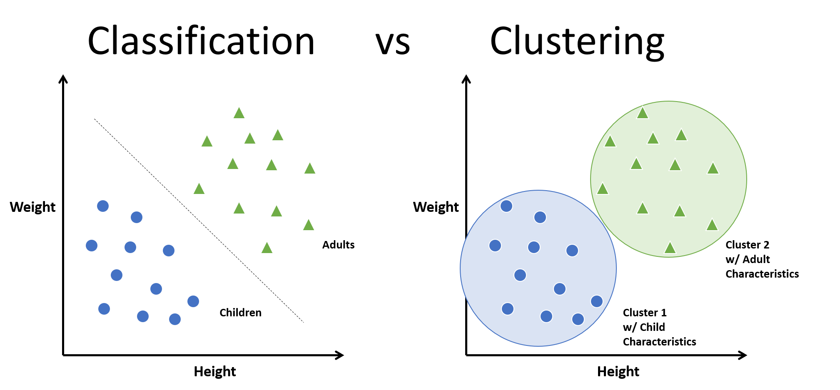
What is Clustering?
Clustering refers to the process of generating labeled groups of data based on how similar they are. Clustering is similar to Classification, but not quite the same…
Characteristics
Clustering is a method of UNSUPERVISED LEARNING
So, it has no target or ground truth to estimate.
Does not have a specific label order
Can group the data through different methods:
K-means
K-nearest neighbors
Hierarchical
Classification vs Clustering

Slide 3
Hello World!

